Slide 1


Billy
8 November 2022

Slide 2

Outline
Executive Summary
Introduction
Methodology
Results
Conclusion
Appendix

Slide 3
Executive Summary
Summary of methodologies
Create a machine learning pipeline to predict if the first stage will land given the data provided from a certain API or through data scraping. Falcon 9 rocket launches data will be analyzed to gain insights for the trend in success due to certain rocket operation variable.
Summary of all results
Space X advertises Falcon 9 rocket launches on its website with a cost of 62 million dollars; other providers cost upward of 165 million dollars each, much of the savings is because Space X can reuse the first stage. Therefore, if we can determine if the first stage will land, we can determine the cost of a launch. This information can be used if an alternate company wants to bid against space X for a rocket launch.

Slide 4
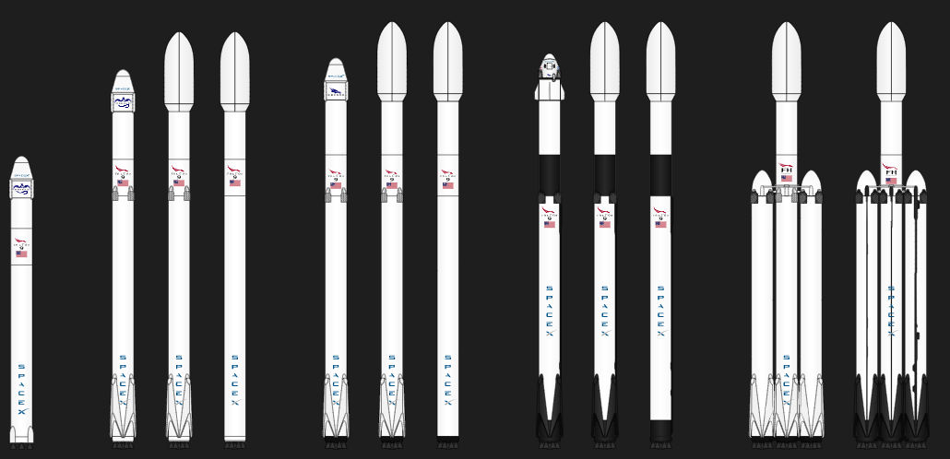
The commercial space age is here, companies are making space travel affordable for everyone. Virgin Galactic is providing suborbital spaceflights. Rocket Lab is a small satellite provider. Blue Origin manufactures sub-orbital and orbital reusable rockets. Perhaps the most successful is Space X. Space X’s accomplishments include Sending spacecraft to the International Space Station. Starlink, a satellite internet constellation providing satellite Internet access. Sending manned missions to Space. One reason SpaceX can do this is the rocket launches are relatively inexpensive. SpaceX advertises Falcon 9 rocket launches on its website with a cost of 62 million dollars; other providers cost upwards of 165 million dollars each, much of the savings is because SpaceX can reuse the first stage. Therefore, if we can determine if the first stage will land, we can determine the cost of a launch. Spaces X’s Falcon 9 launch like regular rockets. To help us understand the scale of the Falcon 9, we are going to use these diagrams from Forest Katsch, at zlsadesign.com. He is a 3D artist and software engineer. He makes infographics on spaceflight and spacecraft art. He also makes software. The payload is enclosed in the fairings. Stage two, or the second stage, helps bring the payload to orbit, but most of the work is done by the first stage. The first stage is shown here. This stage does most of the work and is much larger than the second stage. Here we see the first stage next to a person and several other landmarks. This stage is quite large and expensive. Unlike other rocket providers, Space X's Falcon 9 Can recover the first stage. Sometimes the first stage does not land. Sometimes it will. Other times, Space X will sacrifice the first stage due to the mission parameters like payload, orbit, and customer.
Introduction – Project background and context

Slide 5

Introduction – Problems to answer
Determine the trend of space X to gain insight for the decision to price the commercial space travel by predicting if the landing will be successful or not based on a couple of independent variable.

Slide 6

Section 1

Slide 7
Methodology
Executive Summary
Data collection methodology:
By using request from API
By using web scraping
Perform data wrangling
Simple data analysis: value count, checking for nulls, determining data types
Create a landing outcome label from Outcome column as feature to predict
Perform exploratory data analysis (EDA) using visualization and SQL
Perform interactive visual analytics using Folium and Plotly Dash
Perform predictive analysis using classification models
Using grid search cross-validation method on various classification machine learning method
Analyzing each confusion matrix
Determine which models to use based on the test score accuracy

Slide 8
Data Collection
Data collection process can be divided into two categories:
Collection using requests.get from SpaceX API method,
And web scraping using BeautifulSoup.

Slide 9
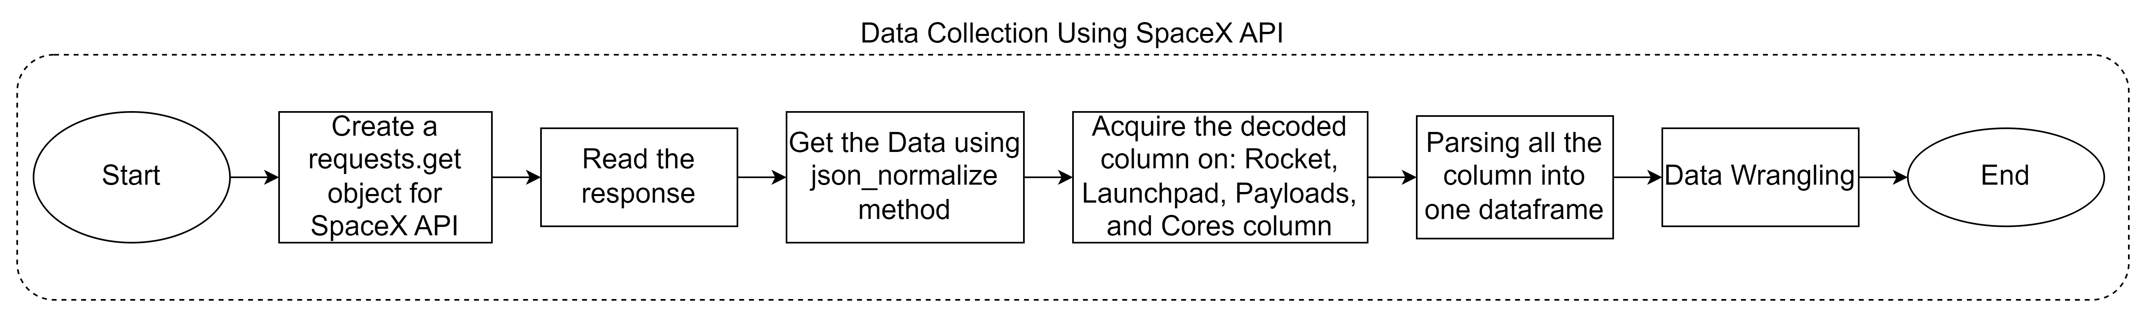
Data Collection – SpaceX API
IBM-Data-Science-Applied-Data-Science-Capstone/jupyter-labs-spacex-data-collection-api.ipynb at main · bil-lekid/IBM-Data-Science-Applied-Data-Science-Capstone (github.com)

Slide 10
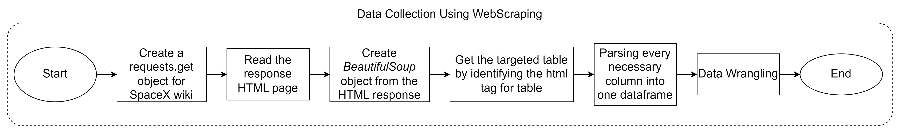
Data Collection – Web scraping in wikipedia
IBM-Data-Science-Applied-Data-Science-Capstone/jupyter-labs-webscraping.ipynb at main · bil-lekid/IBM-Data-Science-Applied-Data-Science-Capstone (github.com)

Slide 11
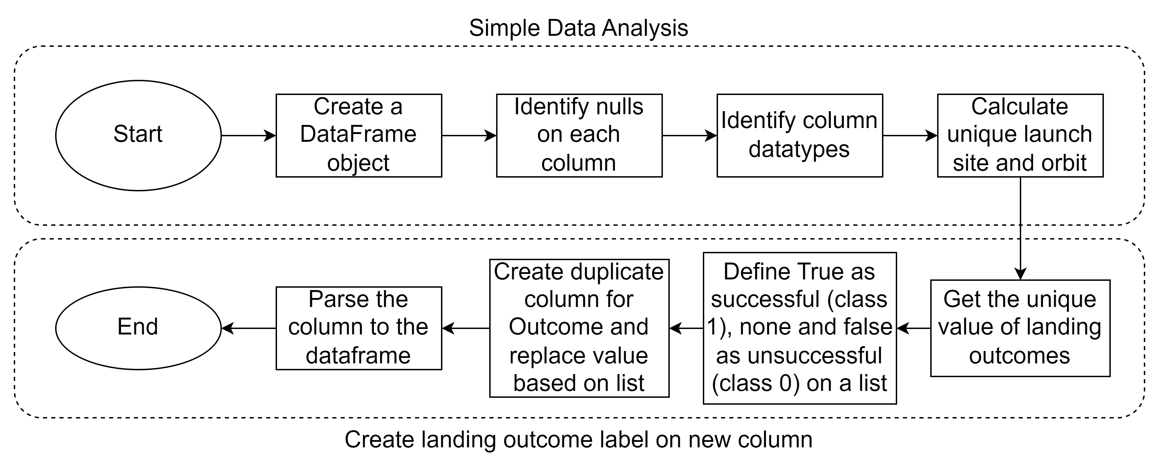
Data Wrangling
IBM-Data-Science-Applied-Data-Science-Capstone/labs-jupyter-spacex-Data wrangling.ipynb at main · bil-lekid/IBM-Data-Science-Applied-Data-Science-Capstone (github.com)

Slide 12
EDA with Data Visualization
Scatter Plot
To analyze the relationship between 2 independent variable towards the success rate. Effectively visualizing the relationship between 3 variable using points and color.
Bar Chart
Visualize success rate based on the orbit type
Line Chart
Visualize success rate growth over the year from 2010 to 2020
IBM-Data-Science-Applied-Data-Science-Capstone/jupyter-labs-eda-dataviz.ipynb at main · bil-lekid/IBM-Data-Science-Applied-Data-Science-Capstone (github.com)

Slide 13
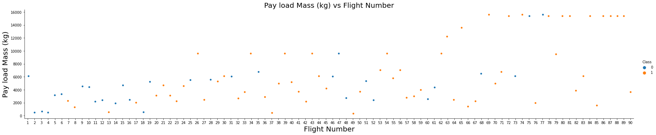
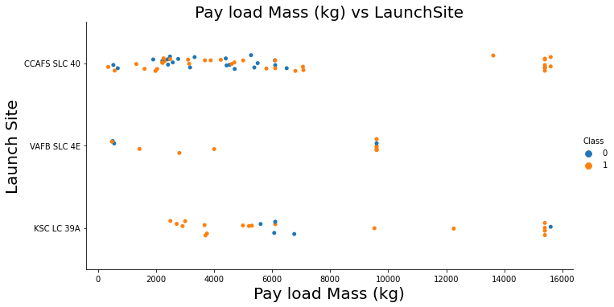
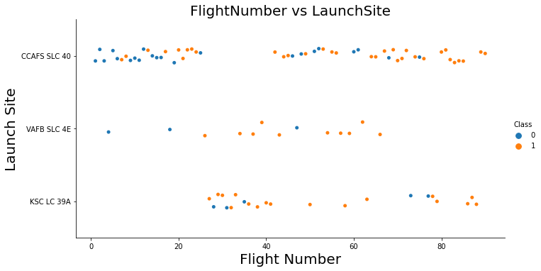
EDA with Data Visualization – Scatter Plot

Slide 14
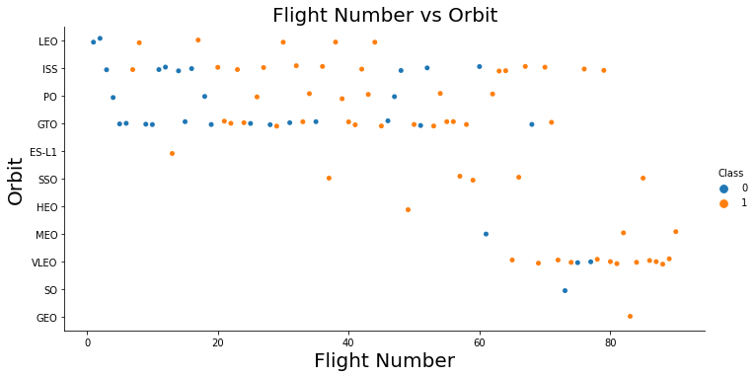
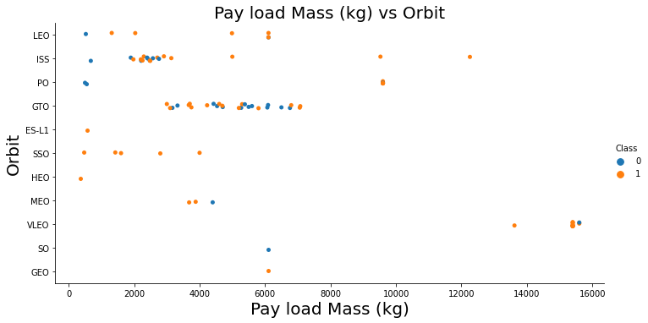
EDA with Data Visualization – Scatter Plot Continuation

Slide 15
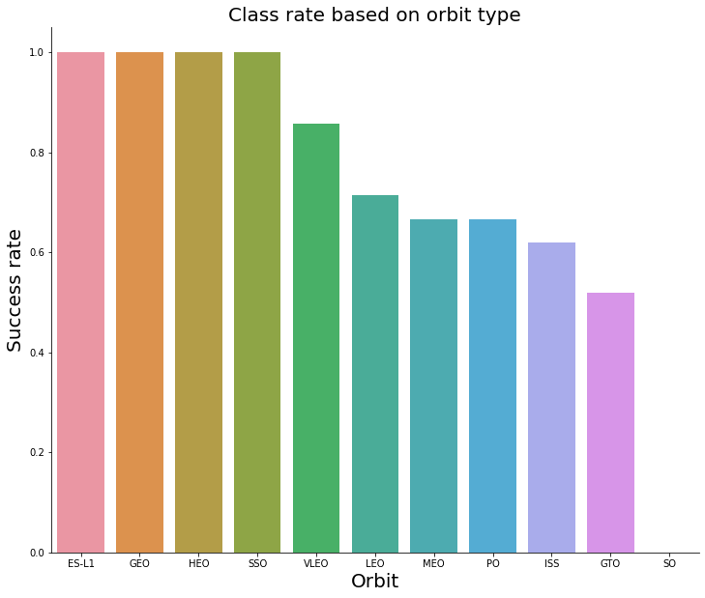
EDA with Data Visualization – Bar Chart

Slide 16
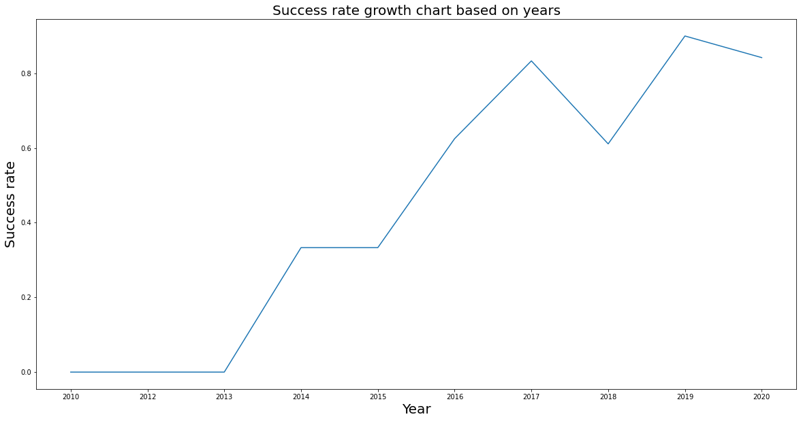
EDA with Data Visualization – Line Chart

Slide 17
EDA with SQL
Display names of unique launch sites in the space mission
Display 5 records where launch sites begin with the string ‘CCA’
Display the total payload mass carried by boosters launched by NASA (CRS)
Display average payload mass carried by booster version F9 v1.1
List the date when the first succesful landing outcome in ground pad was achieved.
List the names of the boosters which have success in drone ship and have payload mass greater than 4000 but less than 6000
List the total number of successful and failure mission outcomes
List the names of the booster versions which have carried the maximum payload mass
List the records which will display the month names, failure landing_outcomes in drone ship ,booster versions, launch_site for the months in year 2015.
Rank the count of successful landing_outcomes between the date 04-06-2010 and 20-03-2017 in descending order
IBM-Data-Science-Applied-Data-Science-Capstone/jupyter-labs-eda-sql-coursera_sqllite.ipynb at main · bil-lekid/IBM-Data-Science-Applied-Data-Science-Capstone (github.com)

Slide 18
Build an Interactive Map with Folium
Add Circle and Marker to mark launch sites
Add marker cluster to show the total of successful landing and unsuccessful landing (green = successful, red = unsuccessful)
Add line with popup and marker to mark distance to closest city, coast, railroad, and highway.
IBM-Data-Science-Applied-Data-Science-Capstone/lab_jupyter_launch_site_location.ipynb at main · bil-lekid/IBM-Data-Science-Applied-Data-Science-Capstone (github.com)

Slide 19
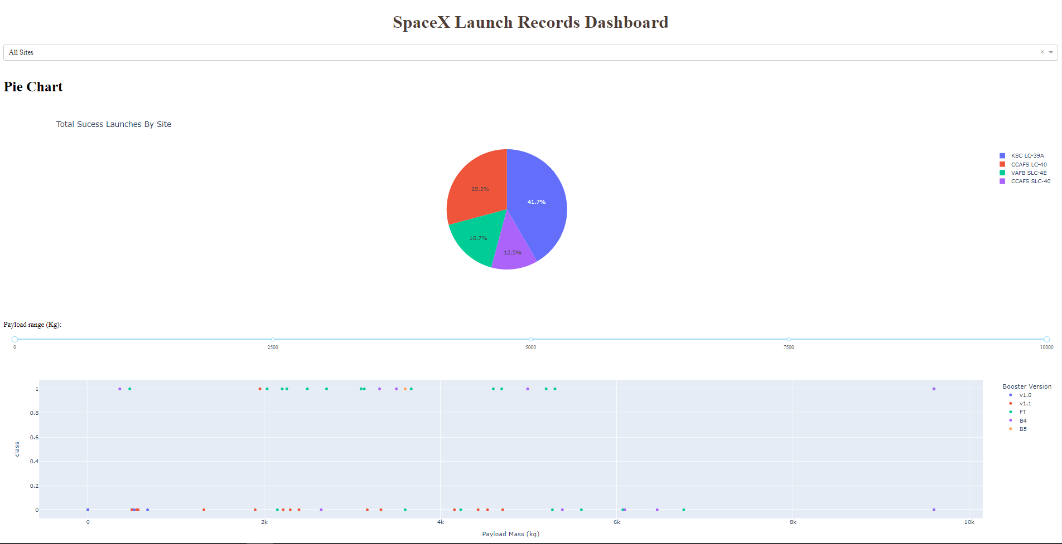
Build a Dashboard with Plotly Dash
Feature
Launch site selection using dropdown
Payload range (Kg) selection using slider
Chart
Total success launches by site using pie chart
Payload Mass (Kg) vs success rate with launch site color labeled using scatter plot
IBM-Data-Science-Applied-Data-Science-Capstone/dashboard.py at main · bil-lekid/IBM-Data-Science-Applied-Data-Science-Capstone (github.com)

Slide 20
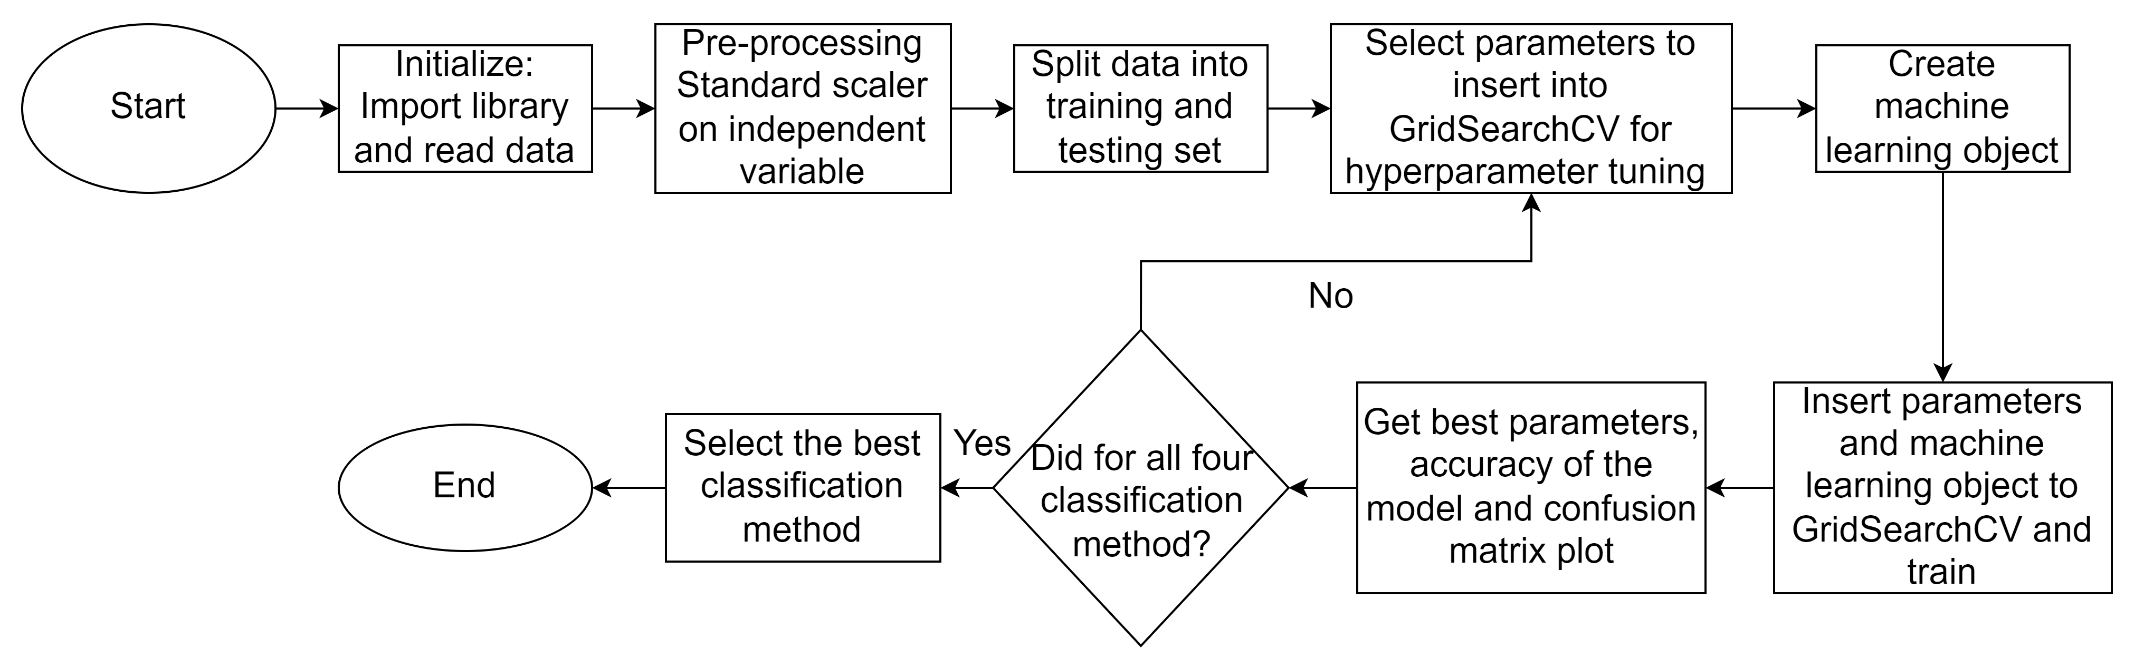
Predictive Analysis (Classification)
IBM-Data-Science-Applied-Data-Science-Capstone/dashboard.py at main · bil-lekid/IBM-Data-Science-Applied-Data-Science-Capstone (github.com)

Slide 21

Section 2

Slide 22
Flight Number vs. Launch Site
For all the launch site as the flight number goes up, there are less unsuccessful landing.

Slide 23
Payload vs. Launch Site
CCAFS SLC 40 launch site have a cluster of successful and unsuccessful landing in the range of 0 to 8000 kg payload mass, but at the range of 13000 to 16000 kg the success rate is 100 %
For the other launch site there seems to be a random cluster of unsuccessful landing at different point. But as the payload mass goes up drastically, the success rate goes up.
The sudden increase in payload mass like outlier might have been intentional since they finally found an optimal payload mass.

Slide 24
Success Rate vs. Orbit Type
There have been 100 % success rate on ES-L1, GEO, HEO, and SSO orbit.
Other 6 orbits had success rate in the range of 0.85 to around 0.5.
SO is the only orbit that had 0 % success rate.

Slide 25
Flight Number vs. Orbit Type
We can see SO orbit only had 1 attempt and it’s unsuccessful, no wonder the success rate is 0 %.
ES-L1, GEO, HEO, and SSO, have relatively low number compared to some orbits like GTO or ISS. To be exact ES-L1, GEO, and HEO only had 1 attempt and it is successful
There seems to be a random cluster or points of unsuccessful mark placed in random places of the chart.
Flight number and orbit doesn’t have any correlation.

Slide 26
Payload vs. Orbit Type
Again, there seems to be no connection. As soon as the payload surpasses 12000 kg, there seems to be a high success rate.

Slide 27
Launch Success Yearly Trend
There are a positive correlation between the success rate as the year goes by. It reached around 90% success rate in 2019.

Slide 28
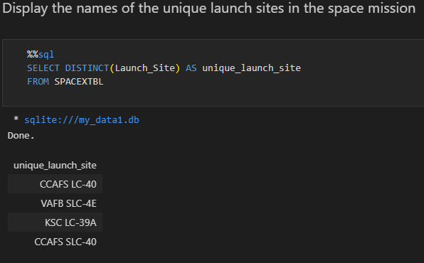
All Launch Site Names
CCAFS LC-40
VAFB SLC-4E
KSC LC-39A
CCAFS SLC-40

Slide 29
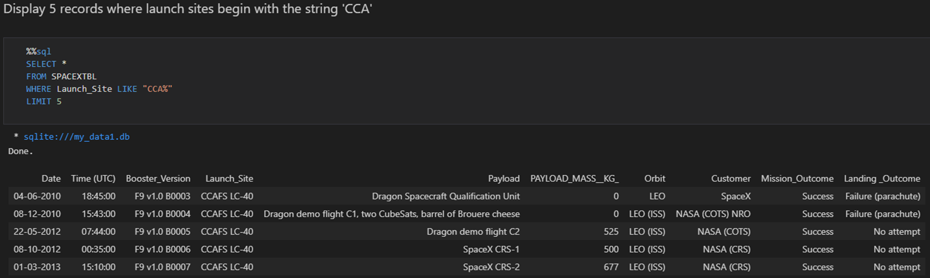
Launch Site Names Begin with 'CCA'
CCAFS LC-40
CCAFS SLC-40

Slide 30
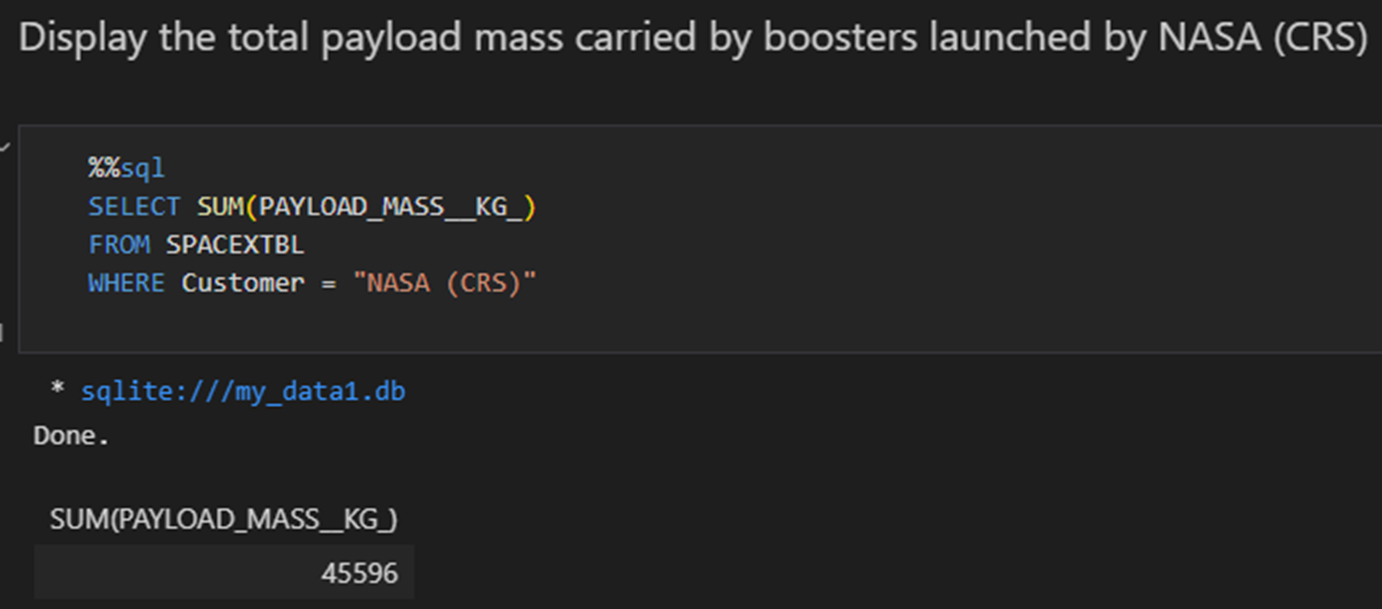
Total Payload Mass
45596

Slide 31
Average Payload Mass by F9 v1.1
2928.4

Slide 32
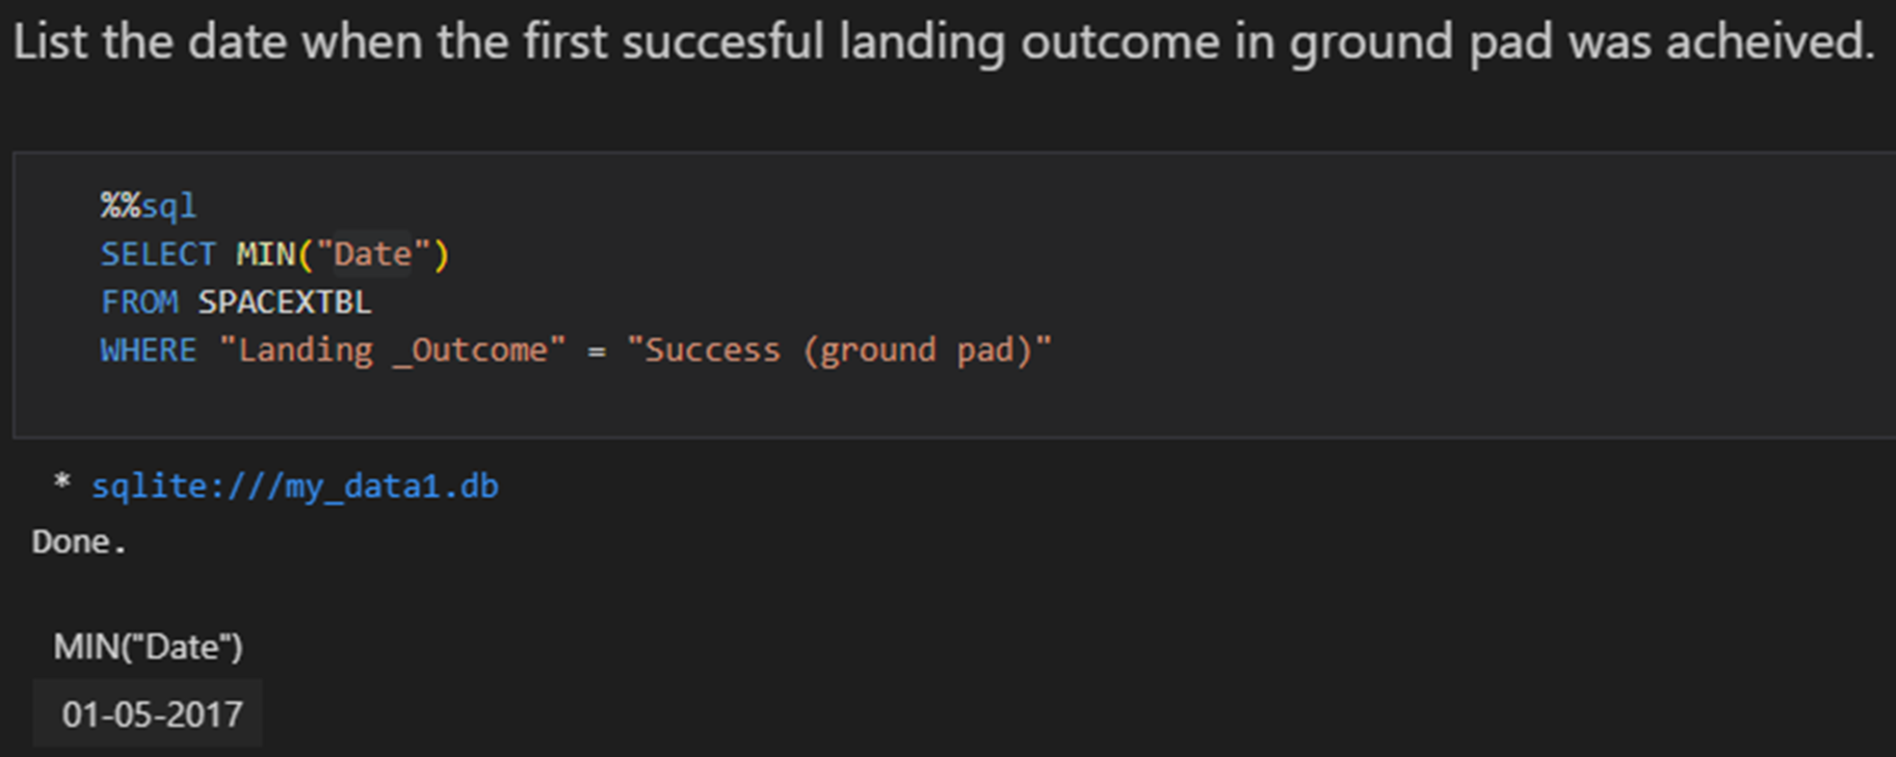
First Successful Ground Landing Date
01-05-2017

Slide 33
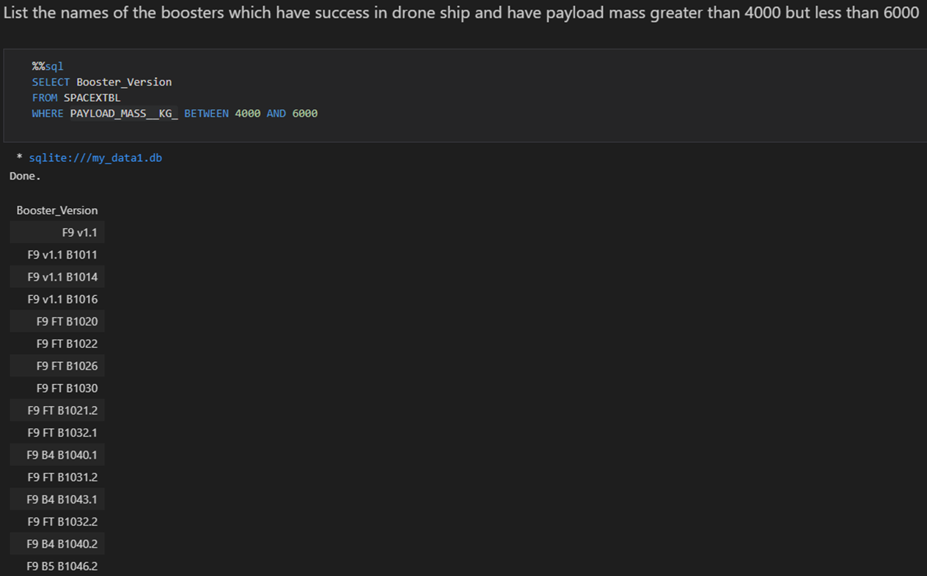
Successful Drone Ship Landing with Payload between 4000 and 6000
F9 v1.1
F9 v1.1 B1011
F9 v1.1 B1014
F9 v1.1 B1016
F9 FT B1020
⁝
F9 B5B1062.1

Slide 34
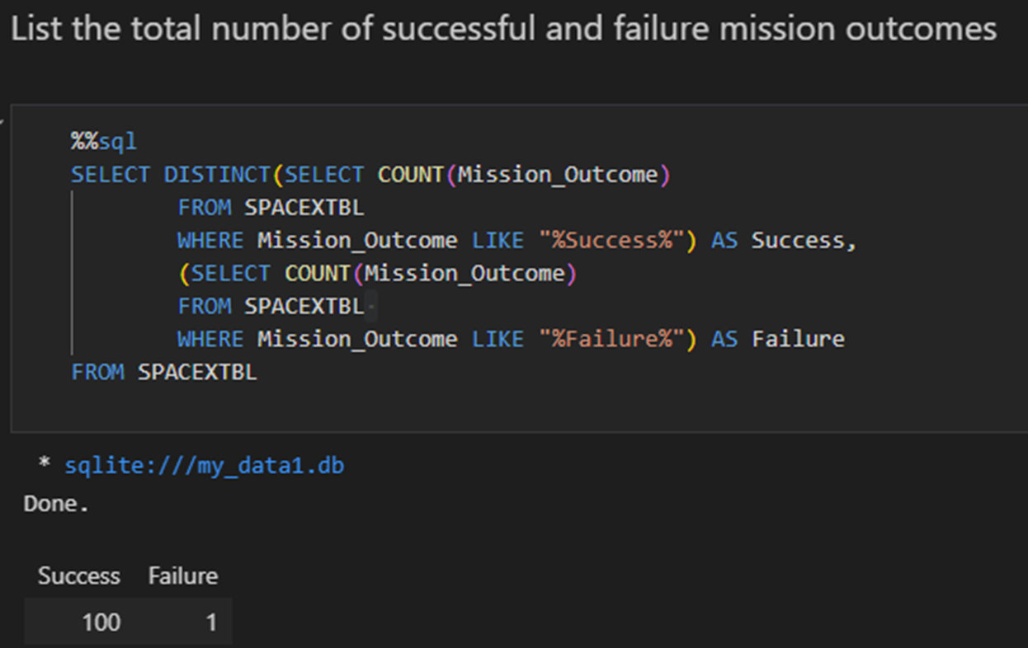
Total Number of Successful and Failure Mission Outcomes
Success = 100
Failure = 1

Slide 35
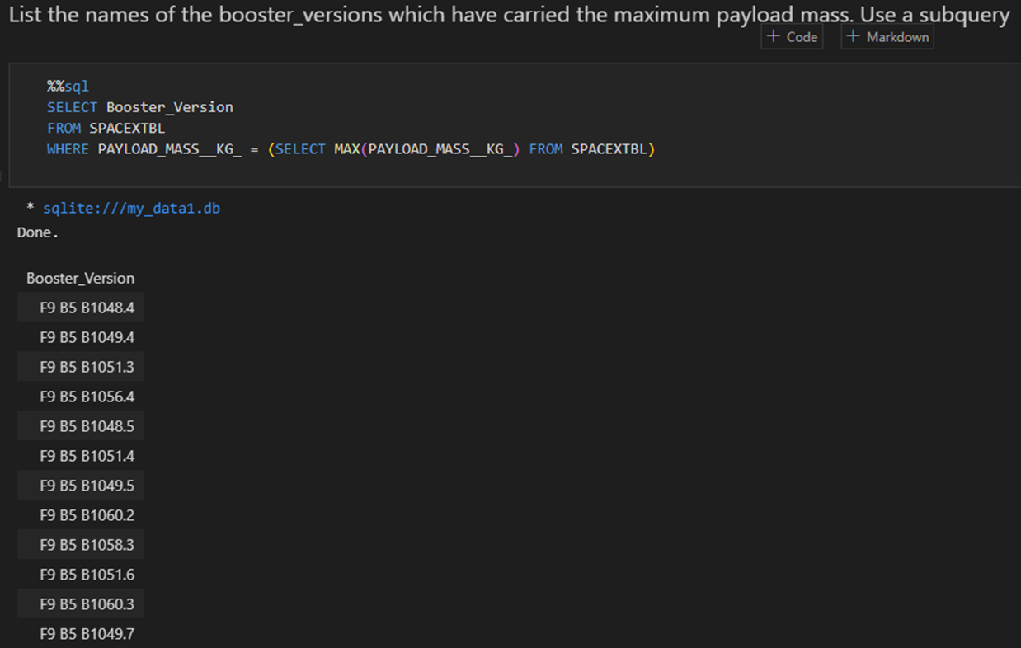
Boosters Carried Maximum Payload
F9 B5 B1048.4
F9 B5 B1049.4
F9 B5 B1051.3
F9 B5 B1056.4
F9 B5 B1048.5
F9 B5 B1051.4
F9 B5 B1049.5
F9 B5 B1060.2
F9 B5 B1058.3
F9 B5 B1051.6
F9 B5 B1060.3
F9 B5 B1049.7

Slide 36
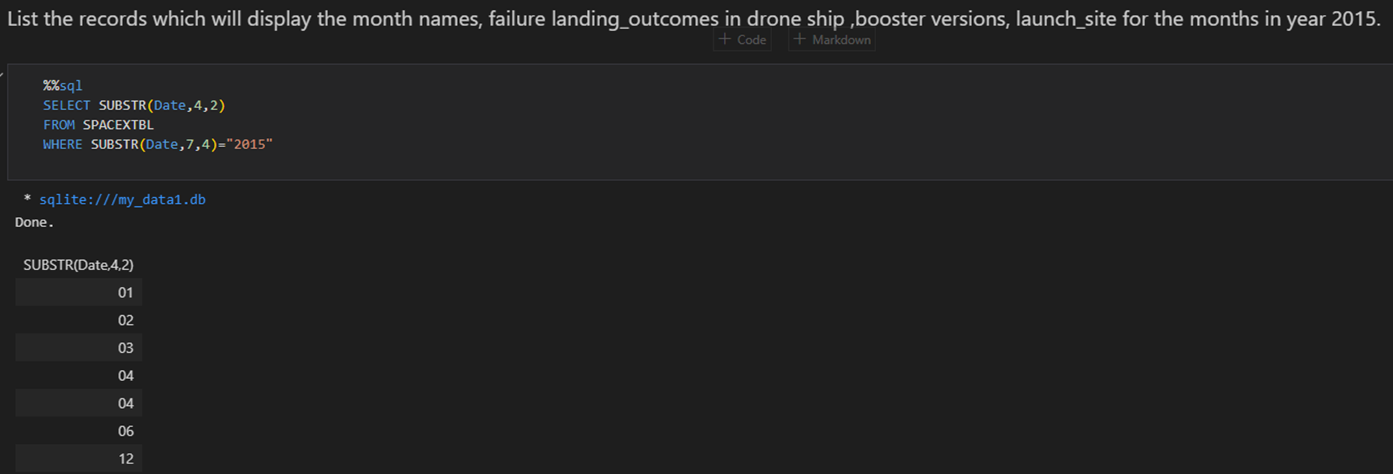
2015 Launch Records
01
02
03
04
04
06
12

Slide 37
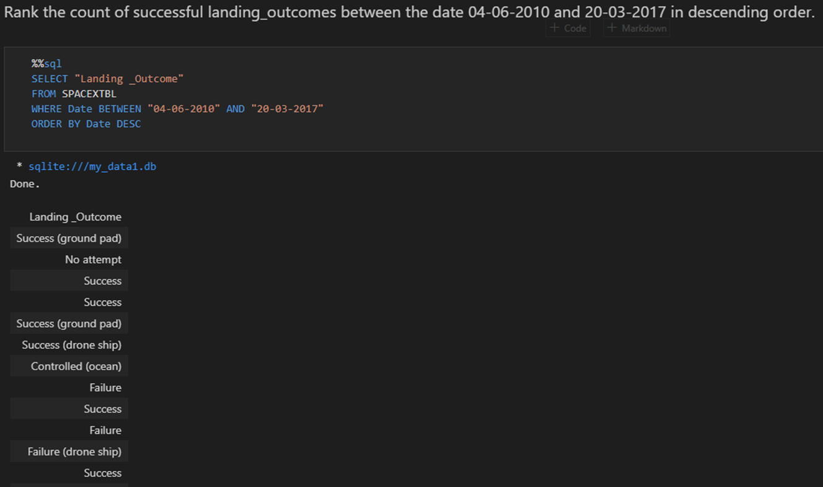
Rank Landing Outcomes Between 2010-06-04 and 2017-03-20
Success (ground pad)
No attempt
Success
Success
Success (ground pad)
Success (drone ship)
Controlled (ocean)
Failure
Success
Failure
Failure (drone ship)
⁝
Failure (parachute)
Success

Slide 38

Section 3

Slide 39
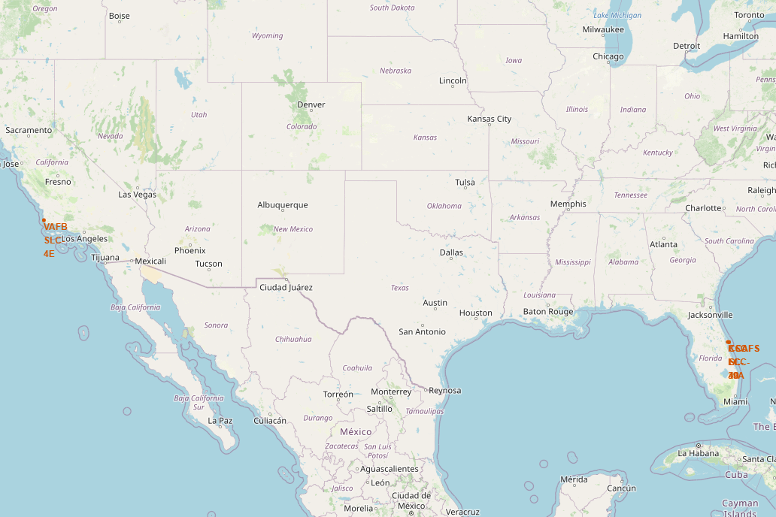
Mark all launch site on map
VAFB SLC-4E Launch site is located at southwest of united states while the rest of the launch sites are located at southeast

Slide 40
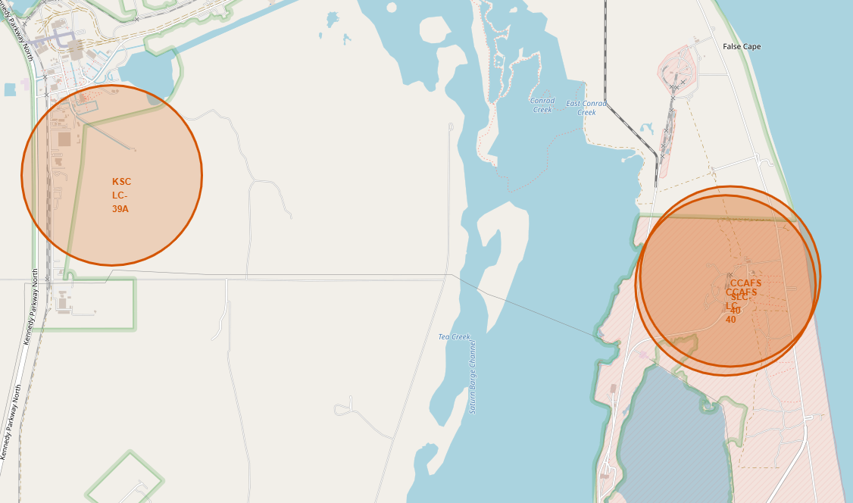
Mark all launch site on map (Continuation)

Slide 41
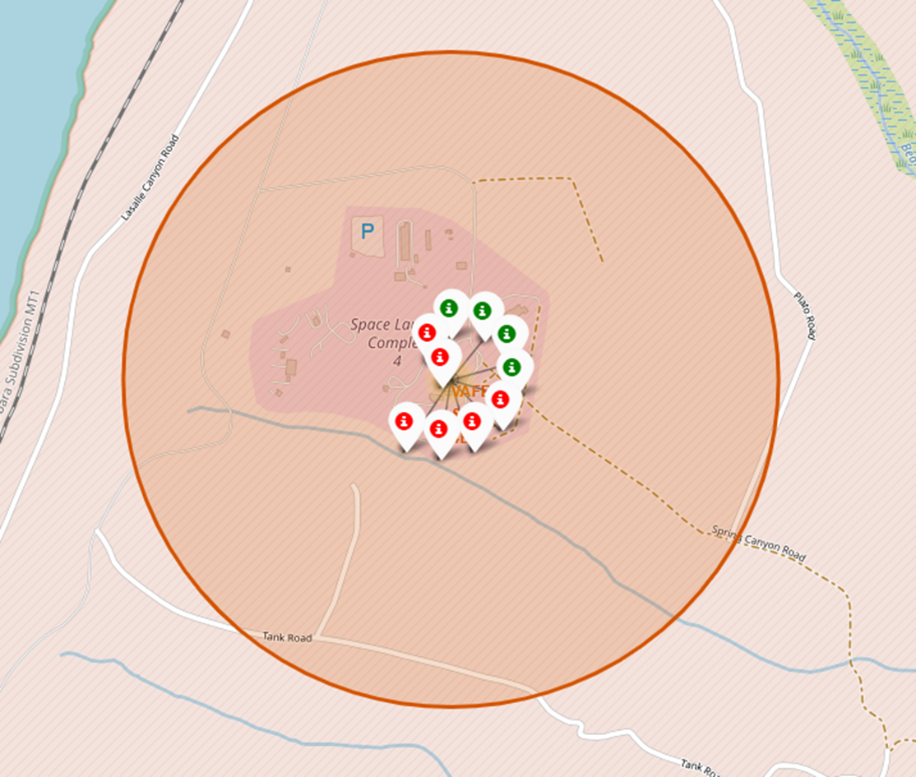
Marking the success/failed launches for each site on the map
Marker cluster is placed on each launch sites based on the amount of unsuccessful and successful launches. The red marker indicates unsuccessful launches in the launch site while the green marker indicates the opposite.
VAFB SLC-4E had 10 launches, 4 success and 6 fail

Slide 42
Marking the success/failed launches for each site on the map (Continuation)
KSC LC-39A had 13 launches, 10 success and 3 failed
CCAFS LC-40 had 26 launches, 7 success and 19 failed
CCAFS SLC-40 had 7 launches, 3 success and 4 failed

Slide 43
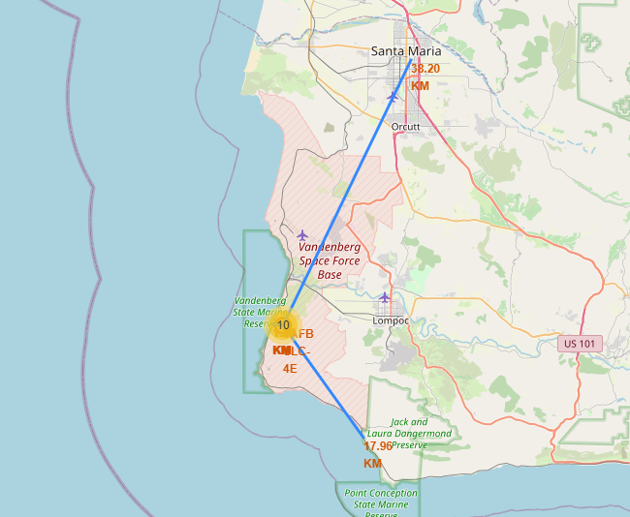
Create a distance marker from the launch site to the nearest city, coast, railway, and highway

Slide 44
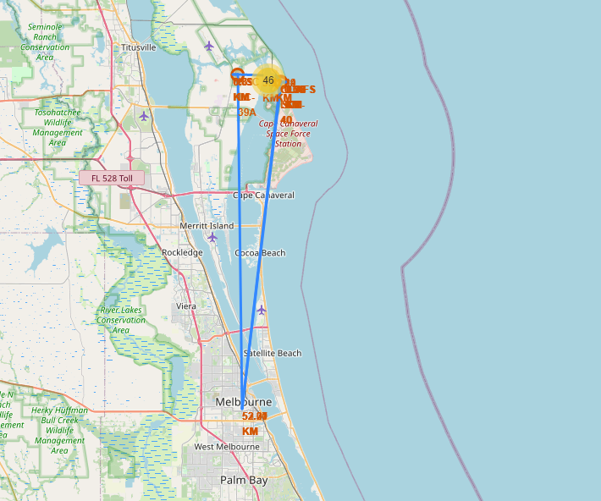
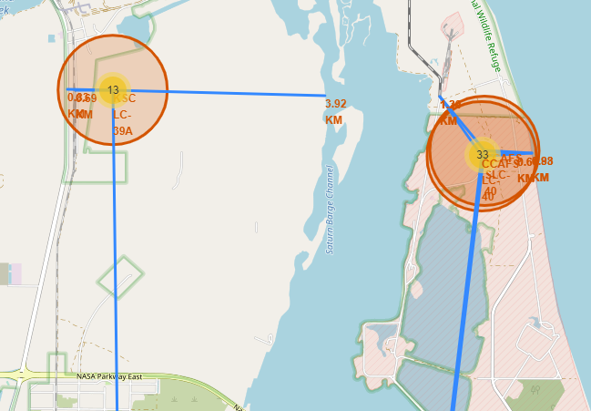
Create a distance marker from the launch site to the nearest city, coast, railway, and highway (Continuation)

Slide 45

Section 4

Slide 46
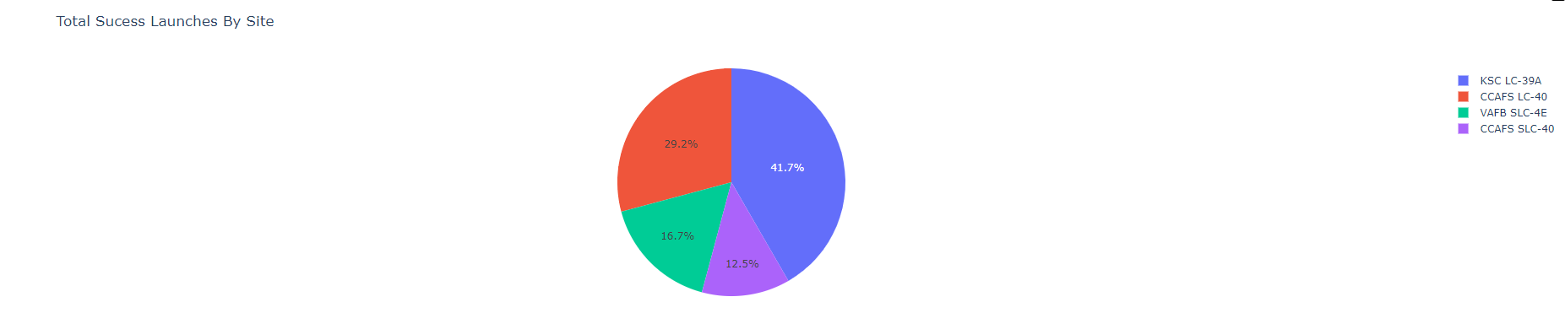
Total Success Launches by All Sites Pie Chart
KSC LC-39A had the most success launches at 41.7 % of the pie, while CCAFS LC-40 had 29.2 %, VAFB SLC-4E had 16.7%, CCAFS SLC-40 had 12.5%.

Slide 47
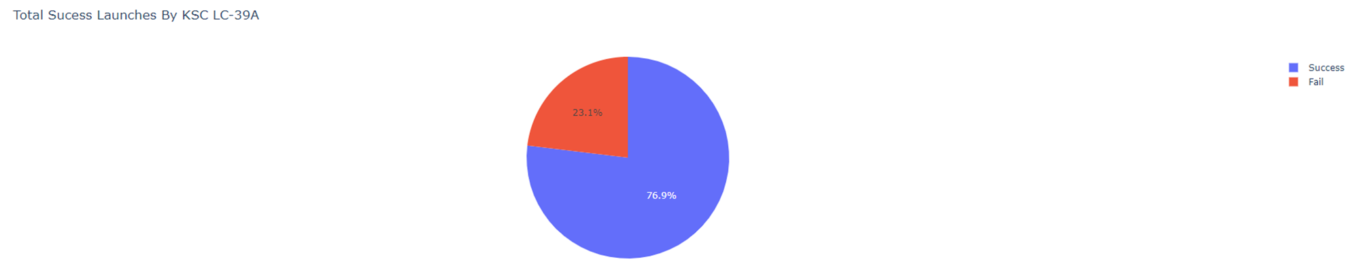
Launch site with the highest launch success ratio Pie Chart
KSC LC-39A is the only launch site with success launches more than fail launches. The launch success ratio is 76.9 % successful launches.

Slide 48
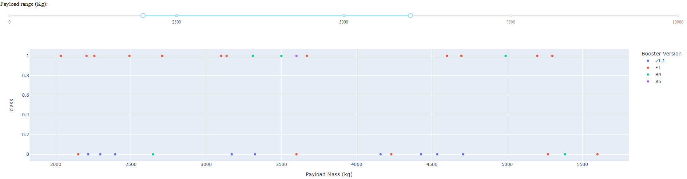
Payload vs Launch Outcome scatter plot
The best payload range is 2000 to 6000 kg for success rate.

Slide 49
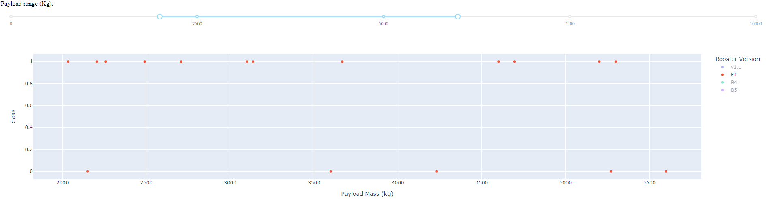
Payload vs Launch Outcome scatter plot (Continuation)
The best booster version would be FT, excluding B5 booster since it is 100 % success rate but only with one sample

Slide 50

Section 5

Slide 51
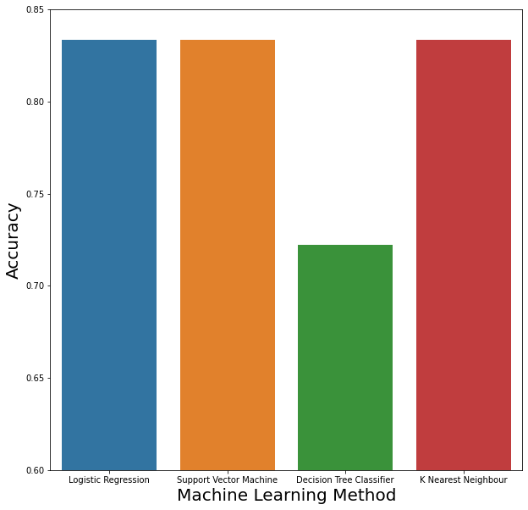
Classification Accuracy
Logistic regression, support vector machine, and K nearest neighbor all had the accuracy of 0.8334 after calculating the score using the test data.
Decision tree classifier had accuracy score of 0.7222

Slide 52
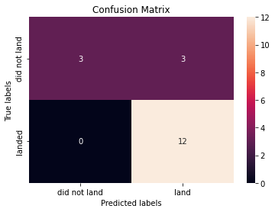
Confusion Matrix
True Positive (TP) = 12
True Negative (TN) = 3
False Positive (FP) = 0
False Negative (FN) = 3
The positive prediction had good accuracy since it successfully predicted all right.
The negative prediction had mediocre and almost bad accuracy since the amount of false negative is equal to the true negative

Slide 53
Conclusions
Data is collected by two methods, using SpaceX API and web scraping. The collected data will be wrangled before proceeding.
There have been a relation between payload mass and success rate, which in specific huge payload mass the success based on orbit or launch site is relatively higher.
There have been uptrend of success rate from 2010 to 2021
By using SQL, it is possible to perform advanced exploratory data analysis on specific filter such as average of a certain column or data based on dates.
By using folium and dash, it is possible to create a dashboard and interactive map chart to furthermore simplify data analysis for stakeholder presentation.
The best classification method on test data based on accuracy is logistic regression, support vector machine, and K nearest neighbor. The models can predict if the launch is going to be successful or not based on 15 independent variable, the models had an accuracy of 0.8334.

Slide 54


